Slide 1

Proposal Presentation
Development and Validation of a Dexterous Hand System
··· Dexhand Designed by The Robot Studio···
Team Members: Jincheng Tian, GuangTian Liu, ZhongHao Zhao
2026/3/11
Notes:
Hello,everyone. We are group2, and we focus on dexterous right hand. So our project is about Development and Validation of a Dexterous Hand System which designed by the robot studio

Slide 2
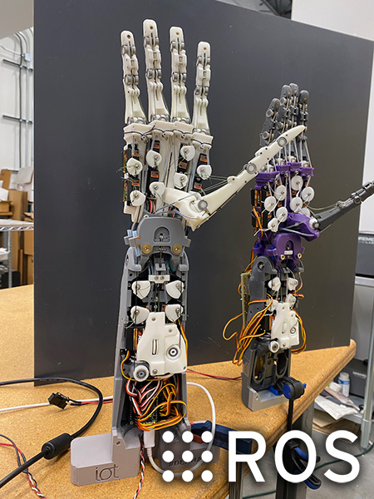
Introduction
What is Dexhand
DexHand is an open-source dexterous hand for humanoid robotics research, balancing low cost, reproducibility, and extensibility across mechanical design, control, and simulation.
Project Development
Dexhand Whole Body
Project Origin
Proposed and released as an open-source V1 design by Rob Knight
Hardware Maturity
The IoT Design Shop continuously improved the BOM, assembly wiki, and design iterations, making the robotic hand easier to replicate, wire, and debug.
Control Expansion
In August 2023, BLE firmware and electronics setup documentation were released, supporting the Arduino Nano RP2040 Connect-based control architecture.
Software Ecosystem
In October 2023, ROS 2 support was introduced, together with URDF and RViz visualization/demo packages, facilitating simulation and secondary development.
Source: https://www.dexhand.org/
Notes:
DexHand is an open-source bionic dexterous hand project with solid hardware, software, and ROS2 simulation support.
It also supports 3D-printed fabrication and offers low cost, good reproducibility, and strong scalability, making it suitable for secondary development.
Therefore, we chose it as our reference project. The physical DexHand prototype is shown on the right.
DexHand 是一个开源的仿生灵巧手项目，其发展时间较长，具备较完整的硬件基础、软件生态以及 ROS 仿真支持.
并支持 3D 打印制造。项目兼顾低成本、可复现性与可扩展性，适用于二次开发，
所以我们选择这个项目作为参考。右侧是dexhand灵巧手实物图。

Slide 3
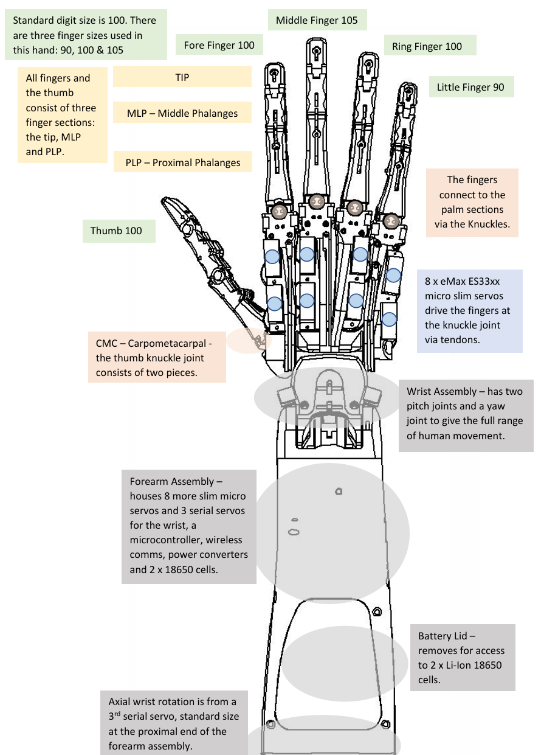
1 Introduction to Dexhand
Introduction
Mechanical Structure of Dexhand
Gantt Chart (Final)
Key Structural Features
Structural Parameters
Finger
Five-finger anthropomorphic layout
3 phalanges per finger
TIP / MLP / PLP joint structure
15 DOF for the fingers
3 DOF for the wrist
Pitch, yaw, and axial wrist rotation
Tendon-driven transmission
Integrated hand–wrist–forearm architecture
Five-finger biomimetic design with three phalanges: TIP, MLP, and PLP.
Wrist
Provides pitch and yaw for more natural motion.
Forearm
Integrates actuators, power supply, and controller.
Servo
Tendon-driven servos enable coordinated multi-joint motion.
Notes:
左图dexhand的机械结构，其主要有手指，手掌，手腕，前臂组成。它有五根手指，每根手指有三节，由tendon-driven；关于dexhand自由度，每根手指有 3个自由组，手腕有3个自由度；其组件均可通过3d打印；
The left figure shows the mechanical structure of DexHand, which mainly consists of the fingers, palm, wrist, and forearm. It features five fingers, each composed of three segments and driven by a tendon-driven mechanism. Each finger has 3 DoFs, and the wrist has 3 DoFs. Most components can be fabricated by 3D printing.

Slide 4
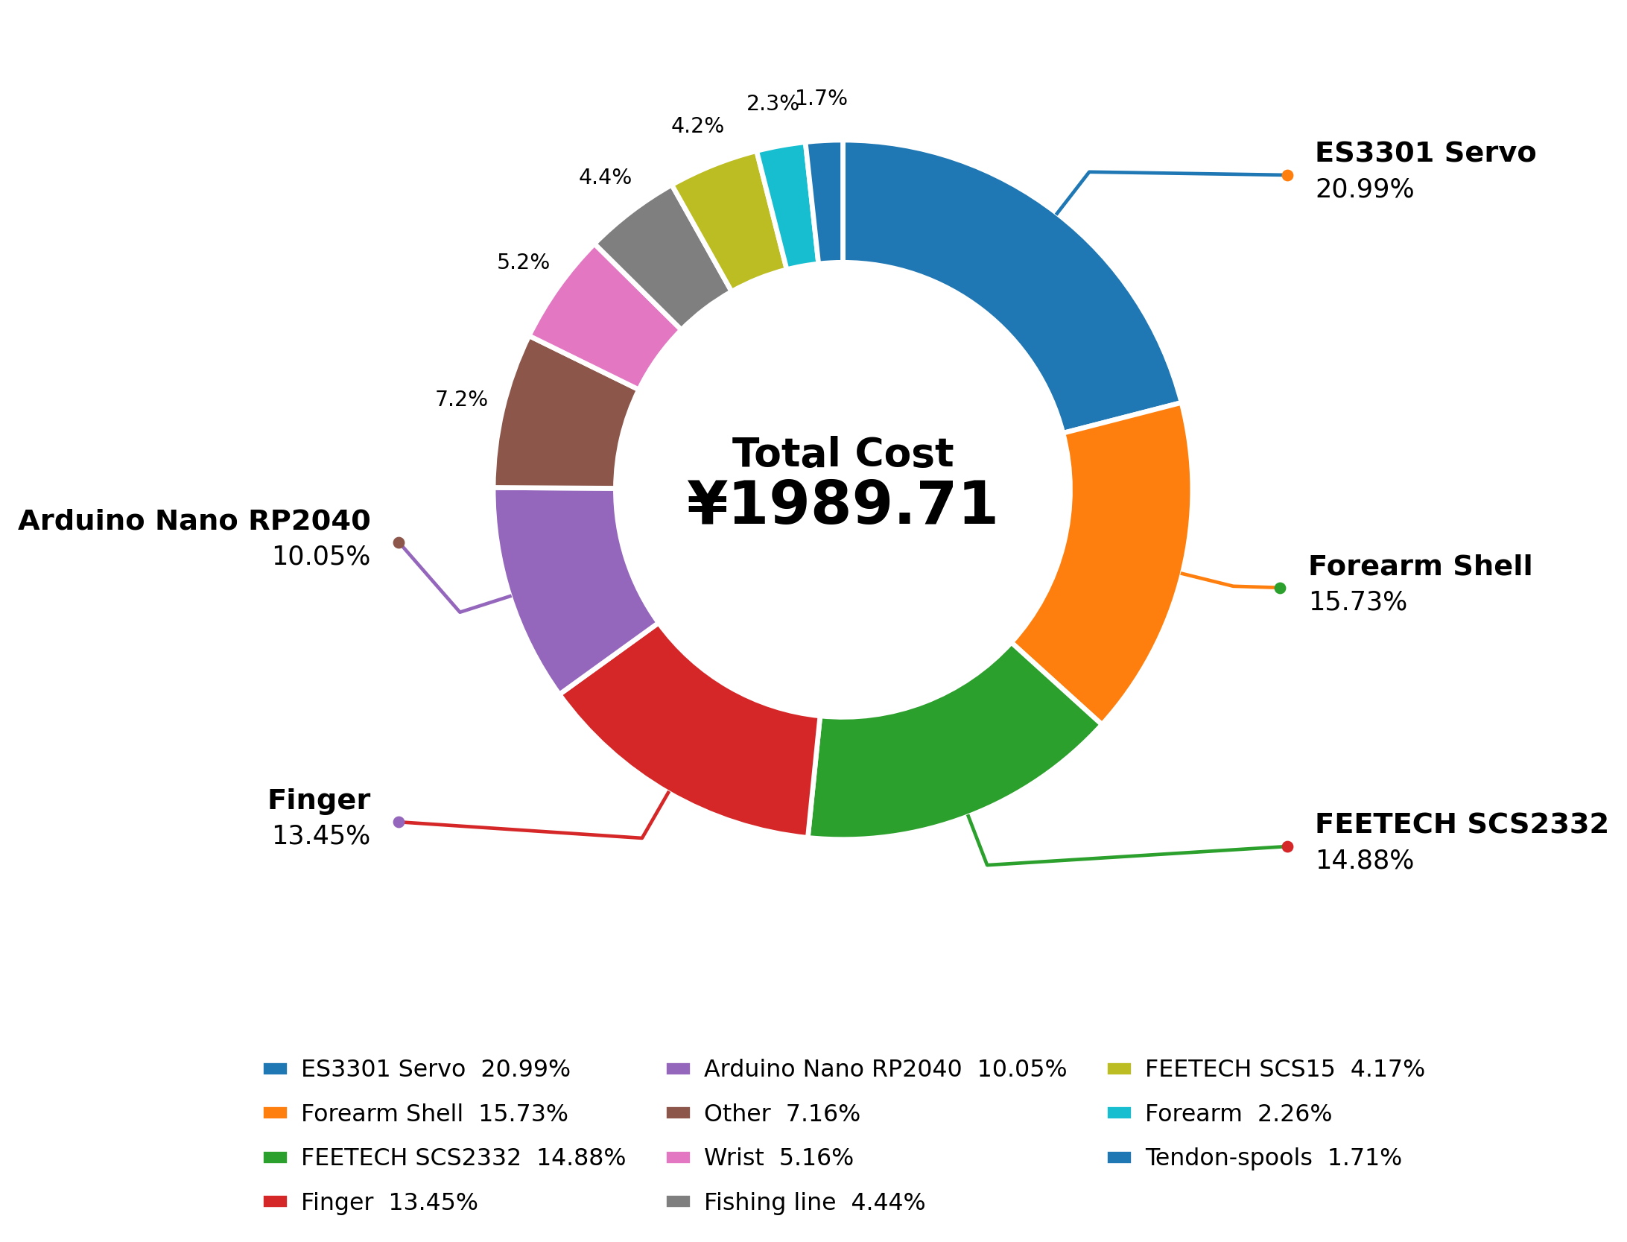
Cost
Material and Progress
Components |  | Cost | Ratio | Satus
Finger | Thumb | 36.41 | 1.83% | Preparing
 | Index | 50.68 | 2.55% | Preparing
 | Middle | 81.34 | 4.09% | Purchased
 | Ring | 48.41 | 2.43% | Preparing
 | Little | 50.77 | 2.55% | Preparing
Wrist |  | 102.67 | 5.16% | Preparing
Forearm |  | 45.05 | 2.26% | Preparing
Forearm Shell |  | 313 | 15.73% | Preparing
tendon-spools |  | 34 | 1.71% | Preparing
Arduino Nano RP2040 Connect |  | 1*200=200 | 10.05% | Purchased
ES3301 Servo |  | 16*26.1=417.6 | 20.99% | Purchased
FEETECH SCS2332 |  | 2*148=296 | 14.88% | Purchased
FEETECH SCS15 |  | 1*83=83 | 4.17% | Purchased
Fishing line No. 8 |  | 1*88.4=88.4 | 4.44% | Purchased
Other (See the BOM table for details) |  | 142.38 | 7.16% | Purchased
Total |  | 1989.71
3D Printing
Joint drive
Other: 4cm*6cm Arduino通用原型板/2.54 排母20pin/2.54 排针20pin/圆柱销套件/M2 螺丝及垫片/螺纹嵌件m2*4*3.5/12编100m灰色/6103滚珠轴承/263滚珠轴承/深沟球轴承6702ZZ/693zz 384/m3*60/m3*70
Notes:
This slide presents the cost budget and procurement progress of DexHand.
The total budget is around RMB 2,000. We have purchased the main hardware and the middle finger components, and we are currently assembling fingers.
As shown in the pie chart, the servos takes the main costs, and the 3D-printed forearm structure make up another largest share of the total cost.
这一页ppt展示了成本预算和采购进度。
左侧表格展示了该灵巧手的各个部件以及对应的成本，总预算在2000人民币左右。我们目前已经购买了相关硬件和中指，正在组装一根手指。其他部件后续购买。
右侧是饼图，可以看到用于手指的16个ES3301舵机和用于手腕屈伸的2个SCS2332舵机和前臂主体的3d打印占比较高。

Slide 5
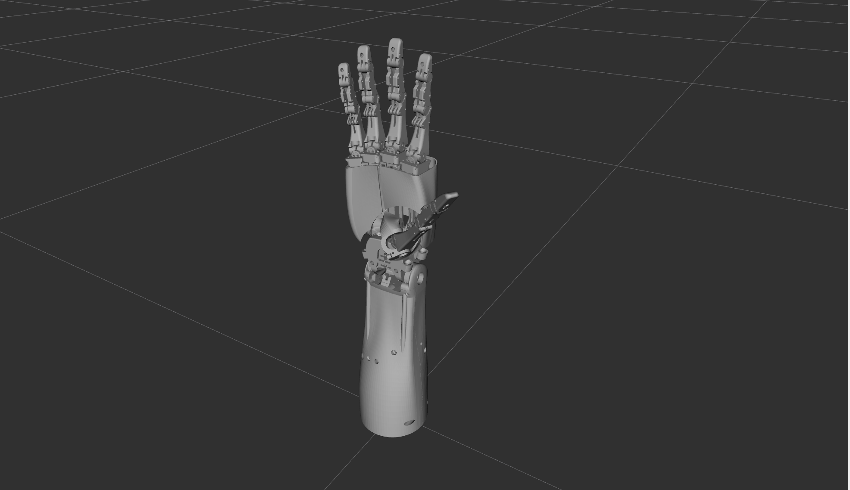
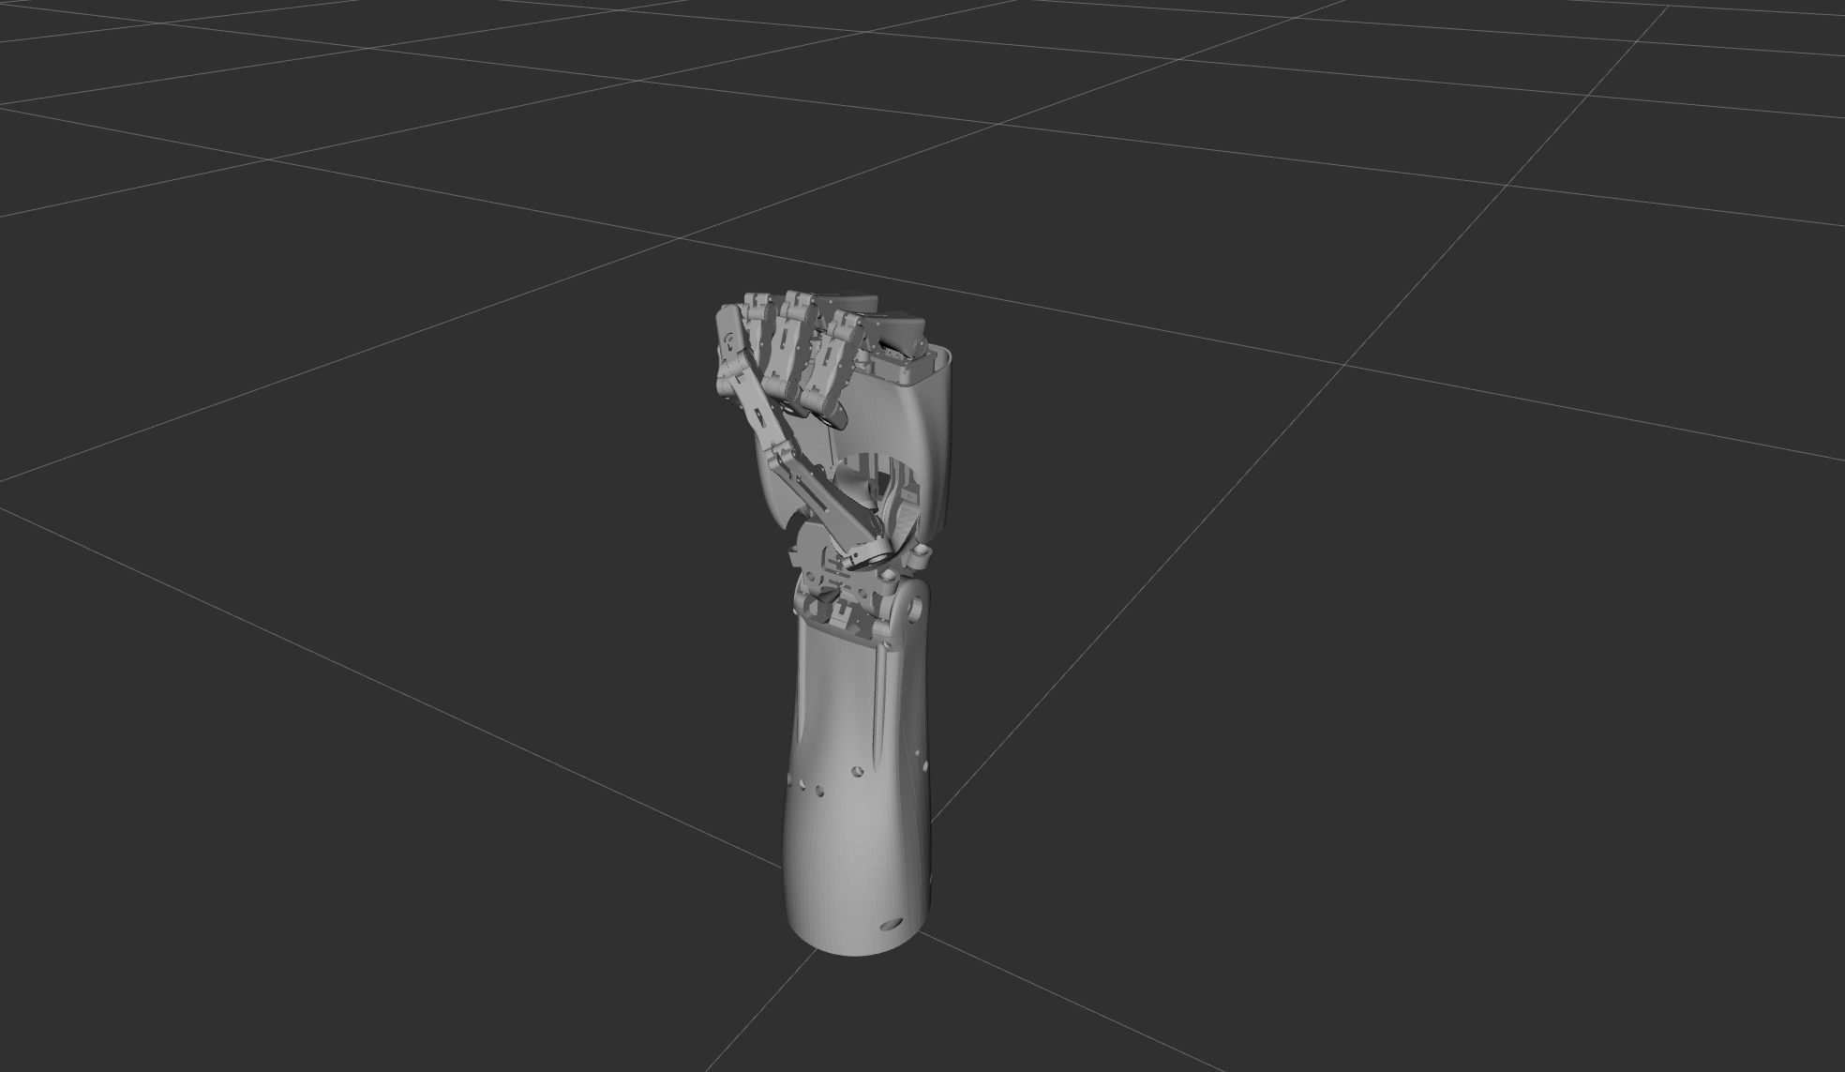
Simulation
ROS2 and Initial Validation
Open-Hand Pose
ROS2 Simulation With Rviz2
Completed Work
Set up the ROS2 simulation environment for DexHand
Successfully launched the dexterous hand model
Verified basic joint and finger motion in simulation
Confirmed the basic visualization and control workflow
Closed-Hand Pose
Outcome
Demonstrated that the DexHand model can be launched, visualized, and controlled in ROS2
Provided a validation basis for later hardware integration
Notes:
And We also run simulation in Ubuntu22.04 and ROS2 humble version for Dexhand. We have completed the simulation environment setup and successfully launched the dexterous hand model. The two figures on the left show the open-hand and closed-hand poses, which verify the basic joint and finger motion in simulation. These results confirm the feasibility of the ROS2-based visualization and control workflow, and provide a validation basis for later hardware integration. 这一页展示的是我们在 DexHand 项目中完成的 ROS2 仿真初步验证。我们已经完成了仿真环境搭建，并成功运行了灵巧手模型。左侧两张图分别展示了张开和闭合两种典型姿态，说明我们已经完成了基础关节和手指运动的验证。该阶段结果表明，DexHand 的 ROS2 可视化与控制流程是可行的，并为后续硬件集成提供了验证基础。

Slide 6
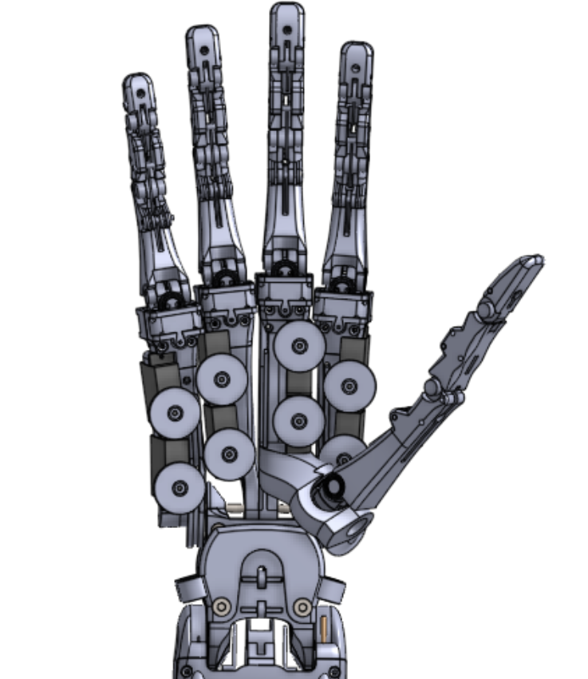

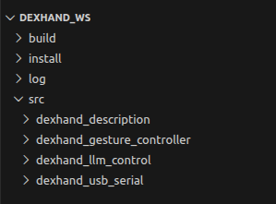
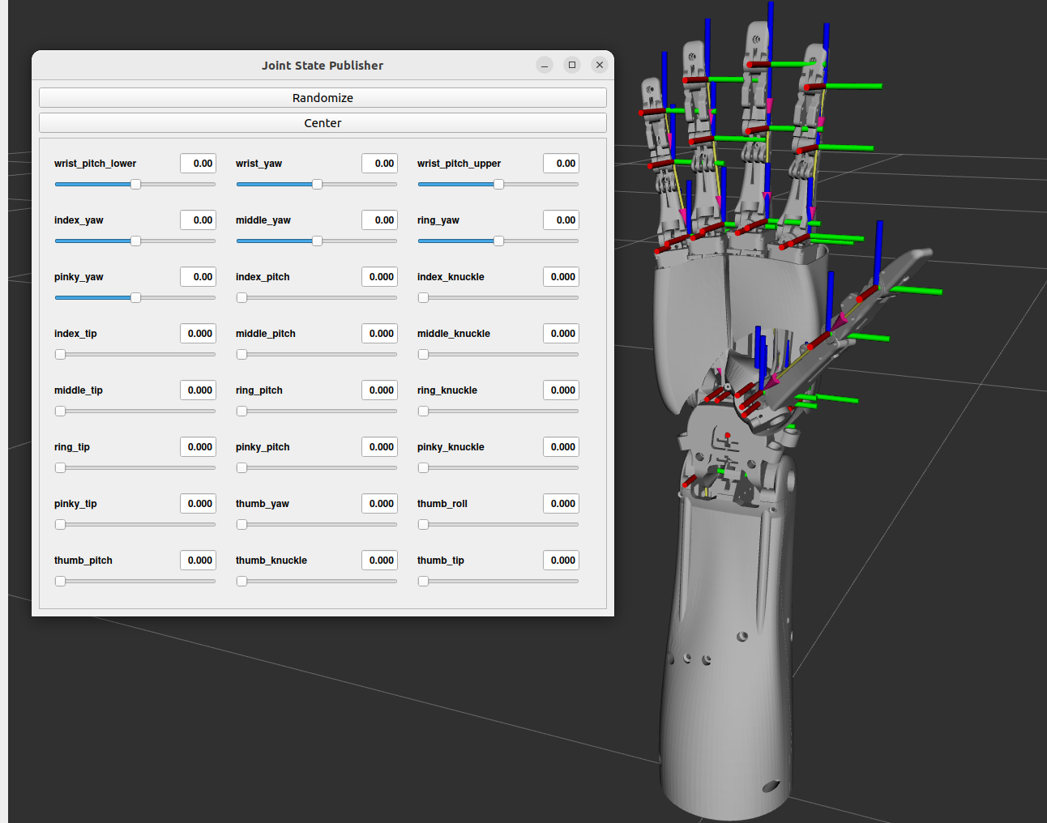
Simulation
System Workflow and Significance
Main Workflow For Simulation
Robot Model
System Understanding
Understood the basic ROS2 simulation workflow of DexHand
Identified the link between robot description, launch files, and motion control
What We Verified
Correct loading and visualization of the hand model
Consistency between commanded motion and simulated poses
Why It Matters
Reduces uncertainty before physical assembly
Supports later hardware integration and future AI-based extensions
Hand Model
ROS2 Launch and Packages
Visualization and Joint Control
Workspace Packages
Motion Verification
RViz Interface
Notes:
This slide presents the ROS2 simulation workflow of DexHand.
The workflow starts from the robot model, then goes through ROS2 launch and packages, visualization and joint control, and finally motion verification. The figures in the middle show the corresponding hand model, workspace packages, and RViz interface.
Based on this process, we understood the main ROS2 simulation pipeline and verified that the hand model can be correctly loaded, visualized, and controlled in simulation. This helps reduce uncertainty before hardware implementation and supports later integration and future AI-based extensions.

Slide 7
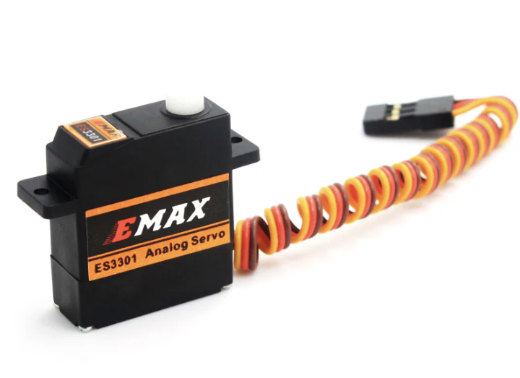
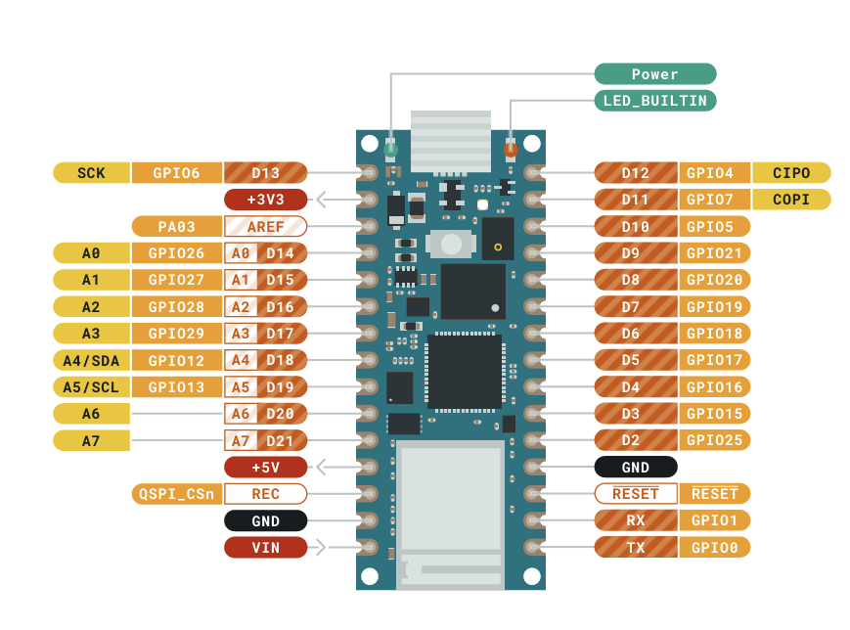
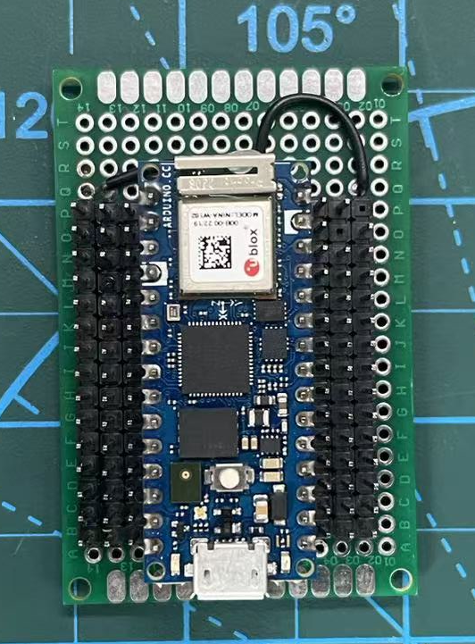
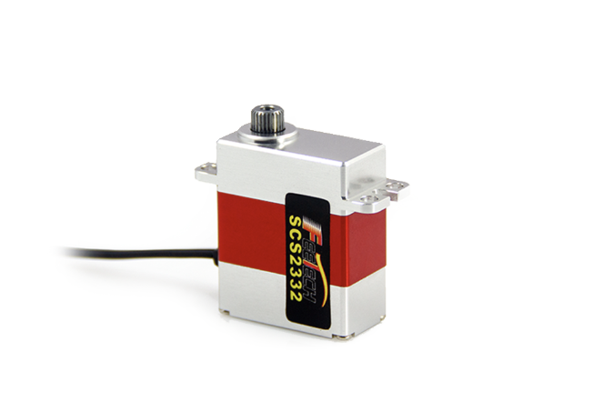
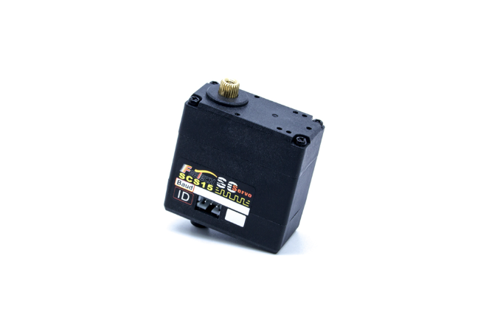
Eletronics
Electronics and Actuation
Main Control
Finger and Thumb Servos ×16
Based on Arduino Nano RP2040 Connect
Fits inside the forearm
Controls all 18 servos
Supports USB serial and Bluetooth LE
ES3301
Wrist Flexion/Extension ×2
Feetech SCS2332
Built from off-the-shelf Arduino and protoboard components
Compact layout designed for forearm integration
Supports multi-servo wiring and signal distribution
Axial Wrist Rotation ×1
Feetech SCS15
Notes:
First, on the left, the main controller is based on the Arduino Nano RP2040 Connect. This board was selected because it is compact enough to fit inside the forearm, while still providing the control and communication capability required for the hand system. It supports both USB serial and Bluetooth Low Energy, which is useful for later debugging, communication, and future system integration.
In addition to the controller itself, DexHand uses a compact protoboard-based control board design. As shown in the middle of the slide, the Arduino Nano Connect is integrated into an assembled control board, which helps organize multi-servo wiring and signal distribution in a compact layout. This is important for fitting the electronics into the forearm structure and supporting the full hand assembly.
On the right, the actuation system is divided into three servo groups according to different functional requirements. The first group is the finger and thumb servos, which are used in the largest quantity and mainly support finger actuation. The second group is the wrist flexion and extension servo, which is responsible for wrist bending motion. The third group is the axial wrist rotation servo, which supports wrist rotation.
So, instead of using a single servo type for the entire system, DexHand adopts a layered servo allocation strategy. Compact servos are used where actuator density is important, while dedicated wrist servos are used for larger and stronger joint motion.
Overall, this slide shows that DexHand uses a controller-centered electronic architecture with function-based servo allocation, which supports compact integration and later hardware implementation.

Slide 8

Embodied AI
LLM-Driven Control & Embodied Interaction
LLM-Enabled Natural Language Control
Video Demonstrate
LLM to ROS 2 Bridge: Acts as a seamless communication link between LLM and the DexHand Gesture Controller.
Embodied Actuation: Enables actions where the dexterous hand serves as a physical output medium for AI-generated responses.
Semantic Task Execution
Mathematical Interaction: LLM can be asked math questions and use hand poses to indicate answers or logic.
Gesture Synthesis: Interprets natural language commands to perform specific gestures, such as a “Devil Horns".
Notes:
On this slide, we focus on the high-level intelligence layer of the DexHand project. By establishing a bridge between GPT-4 and ROS 2, enabled the robotic hand to function as an embodied output device.
As you can see in the accompanying video, the system interprets natural language to perform complex actions—ranging from mathematical interactions to specific gesture synthesis like the ‘Devil Horns’. Our current proposal is to replicate this hardware-software integration and implement the seamless communication link for the control system.“本页我们展示了项目通过建立了GPT4和ROS2直接的桥接，
使机械手能够作为具身智能的输出设备来运行。如演示视频所示，系统能够解析自然语言并执行复杂动作：包括处理数学交互任务，以及根据指令执行特定手势合成。我们目前的提案旨在复现这一软硬件集成方案，并实现用于系统控制的无缝通信链路

Slide 9
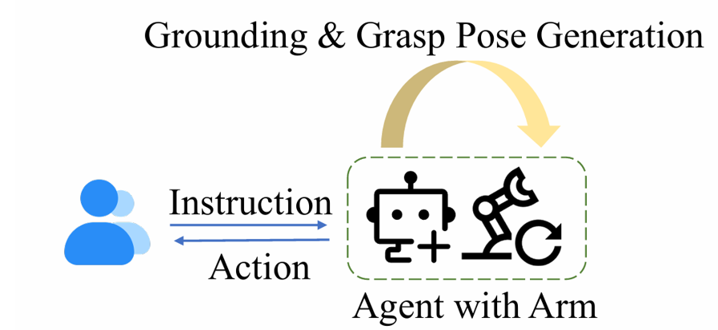
Embodied AI
LLM-Driven Control & Embodied Interaction
How language control achieved
WorkFlow
System Architecture and Control Workflow:
Speech-to-Text Processing: SpeechRecognition package and Google Speech Recognition.
LLM Intelligence Layer: Forwards the text to LLM via the API to parse intent and identify specific hand gestures.
Message Dispatch: Sends validated poses or gestures to the DexHand Gesture Controller.
Dynamic Motion Synthesis(optional):
Generalizable Motion Synthesis: Aims to shift the control logic away from relying solely on built-in firmware actions and pre-defined poses.
Notes:
DexHand provides a viable framework for LLM control. The workflow is straightforward: First, project uses the SpeechRecognition package with Google Speech Recognition to turn voice commands into text. Next, this text is sent to the LLM Intelligence Layer via API. The model parses the user‘s intent and identifies the specific hand gesture needed. Finally, the system dispatches the validated pose to the DexHand Gesture Controller to move the actual hardware. As an optional future goal, if time allows, we want to try Dynamic Motion Synthesis. The idea is to achieve Generalizable Motion Synthesis so we can move past just using built-in firmware actions. This would let the hand perform more flexible, custom movements instead of just playing back pre-set animations. DexHand提供了一个可行的llm控制架构，首先，我们利用 SpeechRecognition 软件包配合 Google 语音识别，把语音指令转成文本。接着，文本会通过 API 传给 LLM 智能层。大模型会解析用户的意图，并匹配对应的手势指令。最后，系统把验证后的姿态下发给 DexHand 手势控制器，驱动硬件做出动作。另外作为一个未来的可选目标，如果进度快的话，我们打算尝试动态运动合成。我们希望实现一种通用化的运动合成方案，从而突破固件内置动作的限制。这样机械手就能做出更灵活的自定义动作，而不仅仅是播放预设好的动画

Slide 10
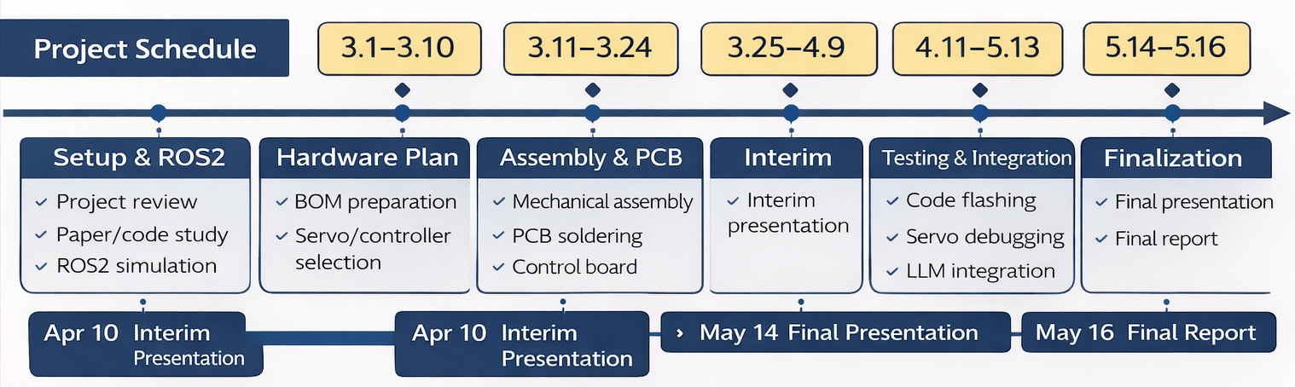
Division
Division of labor for the project
Work Package | Main Tasks | Responsible Member(s) | Expected Output
Mechanical Assembly | 3D-printed part preparation, tendon routing, joint assembly, overall hand structure integration | GuangTian Liu | Completed mechanical structure of DexHand
Electronics and Embedded Testing | Circuit assembly, PCB soldering, firmware upload, microcontroller debugging, servo testing | Jincheng Tian | Functional control board and basic actuator testing
LLM Integration | Study of DexHand software interface, API connection, command design, initial intelligent control exploration | ZhongHao Zhao | Preliminary LLM-based interaction and control framework
Notes:
We divide the project into three work packages: mechanical assembly, electronics and embedded testing, and LLM integration. Each part has a clear task focus and expected output.
In terms of schedule, the project begins with ROS2 simulation and hardware planning, then moves into assembly and PCB preparation, followed by testing, integration, and final optimization. The key milestones are the interim presentation on April 10, the final presentation on May 14, and the final report submission on May 16.
This plan helps us organize the work clearly and keep the project progressing on time.

Slide 11
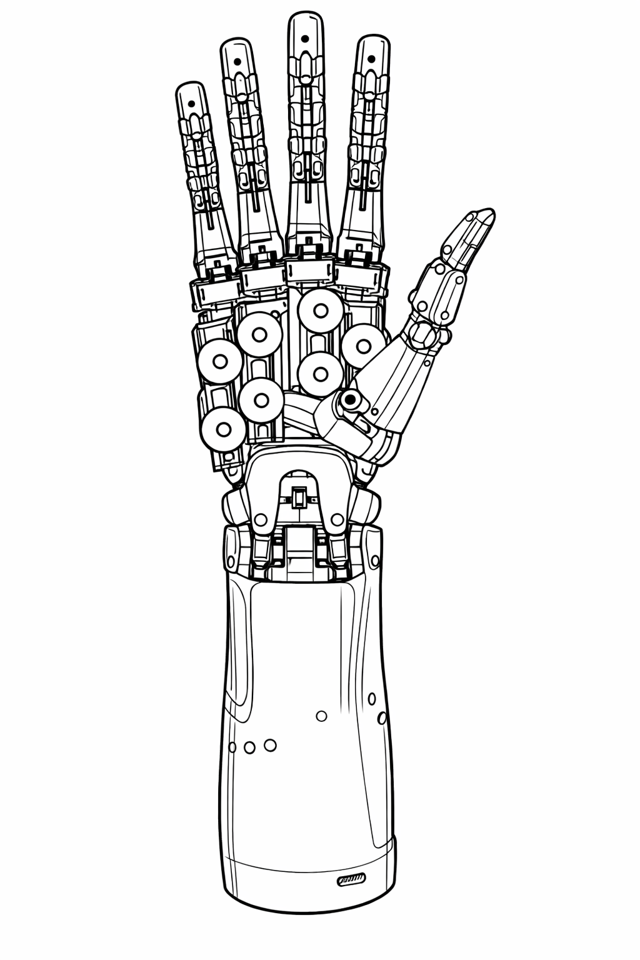
Thank you for listening!
Team Members: Jincheng Tian, GuangTian Liu, ZhongHao Zhao
2026/3/11

